Slide 1
Data Description:
Only 44 samples
Each sample 3 features
Breath Estimation
Apneia
Motion Difference
Label: motion type:
0. No move(17/44)
One side move(15/44)
Two sides move(12/44)
Notes:
Here is our data. We have 44 sample, each sample has 3 features extracted using OPEN-POSE, they are estimated breathing rate, Apneia and Motion Difference between two sides. The label here is Motion, 0 means the body is not moving, 1 means one side is moving, and 2 means two sides of the body are moving. We calculated the portion of these three classes, it seams to be a balanced dataset.

Slide 2
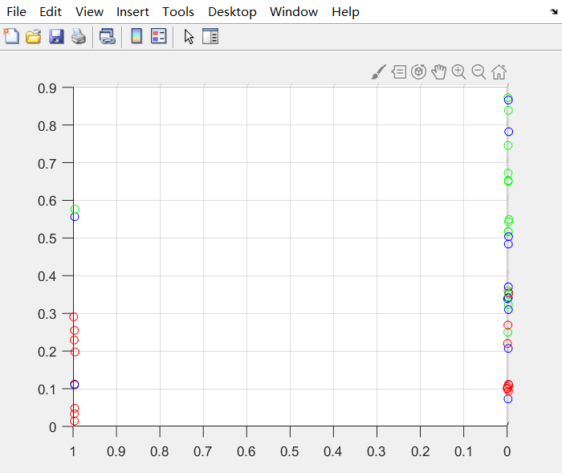
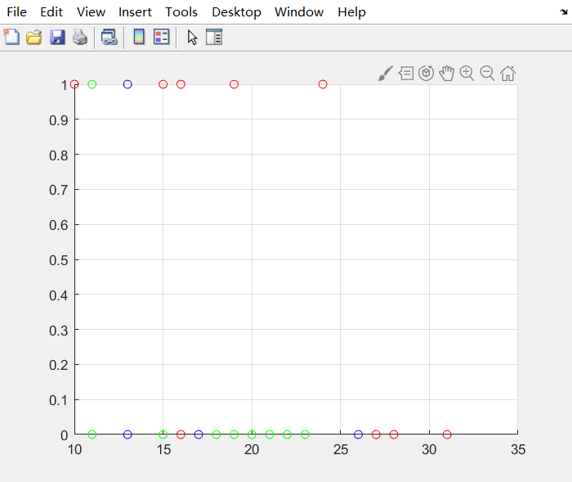
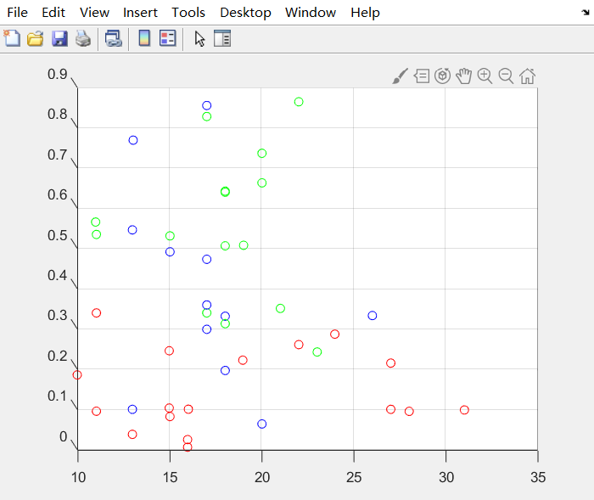
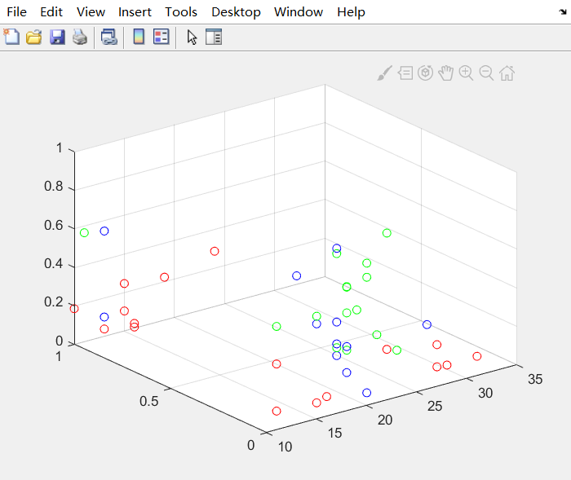
Data Description:
4. Scatter in space
red: class 0
green: class 1
blue: class 2
Notes:
I plot how these points scatter in the space. Here red is for class 0, green is for class 1, blue is for class 2. From the bottom left figure, we can see class 0 is grouped in the bottom part, class 1 is grouped in the upper part, while class 2 is distributed in the whole plane.
So the intuition is that Class 0 and 1 are easy to classified, while we may meet some problems to classify the class 2.

Slide 3

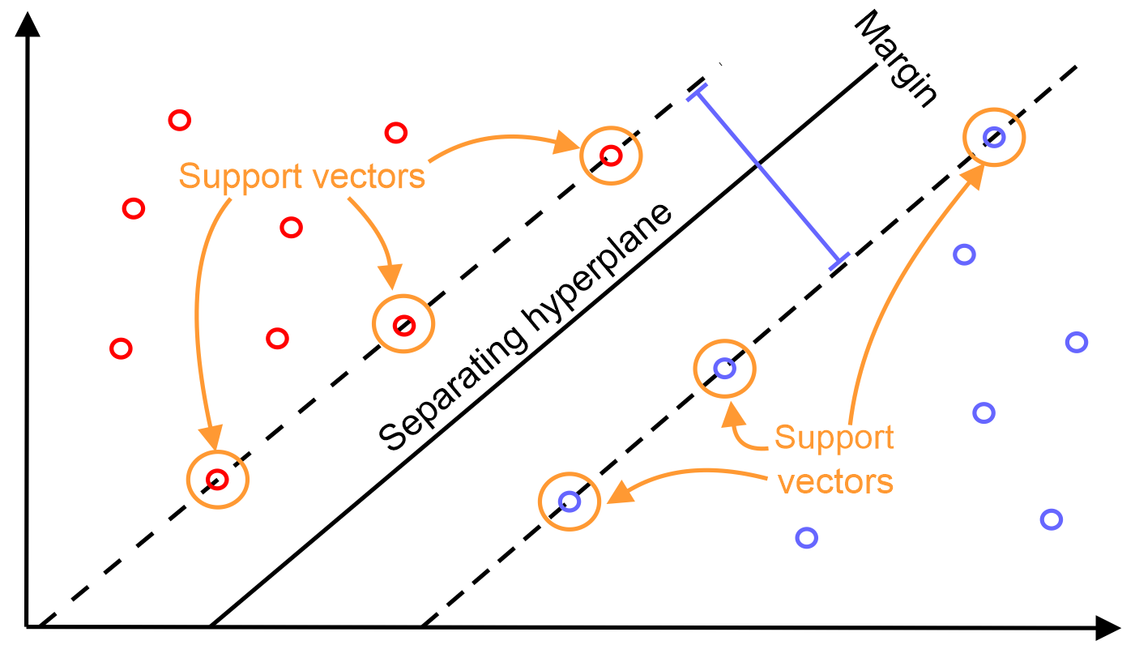
How to train:
Randomly pick 1 sample from 44 samples as test data, and the others as train data.
Repeat 1000 times, to get the Confusion Matrix and Accuracy.
Use SVM(support vector machine) and Random Forests as classifier.
Notes:
Here is how we classify.
Because we have only 44 samples. We randomly pick 1 sample as test data, and the other 43 as train data to train a classifier.
And repeat 1000 times, to get a accurate result.
Here we use SVM and Random Forests as our classifiers.

Slide 4
Results:
SVM:
Random Forest:
1000 | Predicted: 0 | Predicted: 1 | Predicted: 2
Actual:0 | 309 | 63 | 23
Actual:1 | 106 | 198 | 45
Actual:2 | 103 | 153 | 0
1000 | Predicted: 0 | Predicted: 1 | Predicted: 2
Actual:0 | 309 | 47 | 21
Actual:1 | 16 | 189 | 138
Actual:2 | 93 | 171 | 16
Accuracy = 50.7%
Accuracy = 51.4%
Notes:
Here is the result. It seems the result is not good.
I will explain about the result. The table is confusion matrix. The left column is the actual class, the first row is predicted class, and the bold number is the number of right classified. We repeated the train and test process for 1000 times, so the sum of these number is 1000. We can see that, class 0 and class 1 are easy to get classified right and class 2 are difficult to get classified right.
Accuracy for SVM is 50.7%, accuracy for random forest is 51.4%

